Slide 1
Transition Year Programme
Caoimhe Conlon
David O’Callaghan

Slide 2
Practical Programme Brief
Key requirements - students
Suitable for ages 14 - 16
Demonstrate elements relevant to industry
Foster skills such as problem solving, logic analysis
Nurture creativity and curiosity
Repeatable and scalable programme
Interactive elements suitable for science / career fairs
Key requirements - Qualcomm

Slide 3
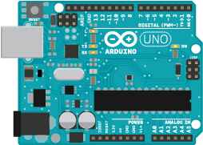
Why Arduino?
Plug and play capability
Hardware and software aspects
Adaptability
Many resources
Relevant to both IT and Engineering
Cost effective (for Qualcomm and students)

Slide 4
Programme Content
Introductory session with mentor
4 days with increasing level of challenge
Initial designs (code and circuits) pre-prepared
Editing and adapting of hardware and software
Demonstration of one program as part of final presentation

Slide 5
Concepts Introduced
Variables
If / else statements
For loops
Switch statements
Functions
Digital and analogue
Editing projects to minimise hardware elements

Slide 6
In the Pack
Arduino Uno board
Component pack
Handbook (for students and mentor)
Clear explanations of how the Arduino operates
Introduction to components and breadboard
Step by step guide to designs
Video guide to initial project
Laptop with Arduino software and internet access

Slide 7
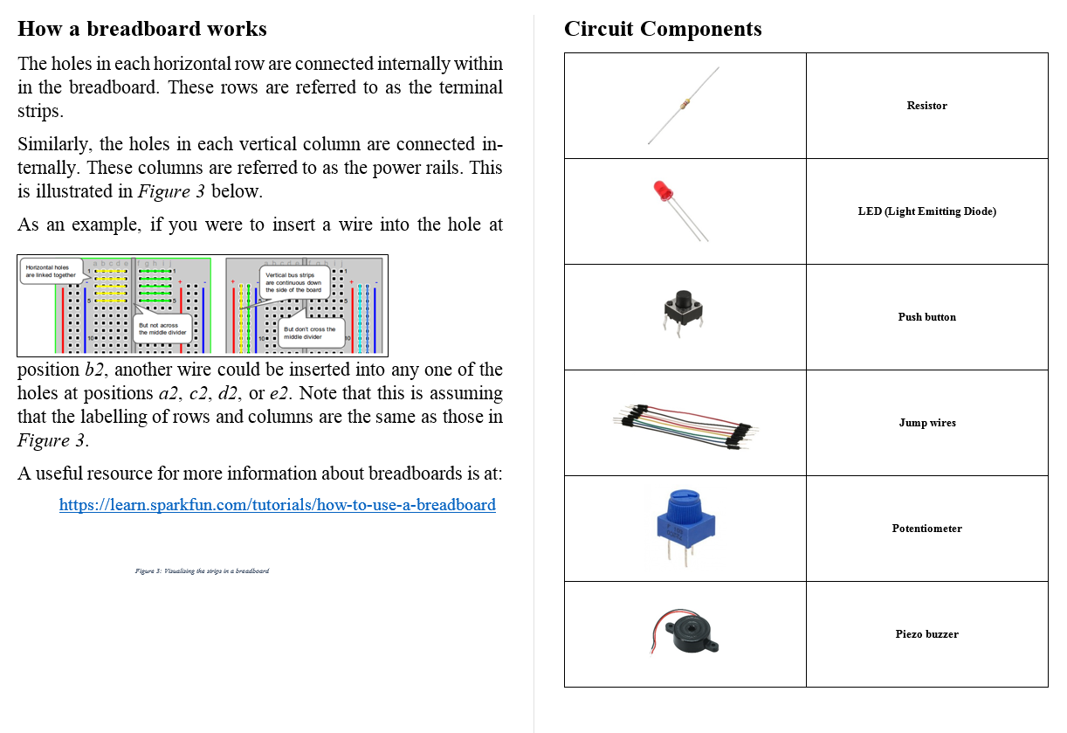
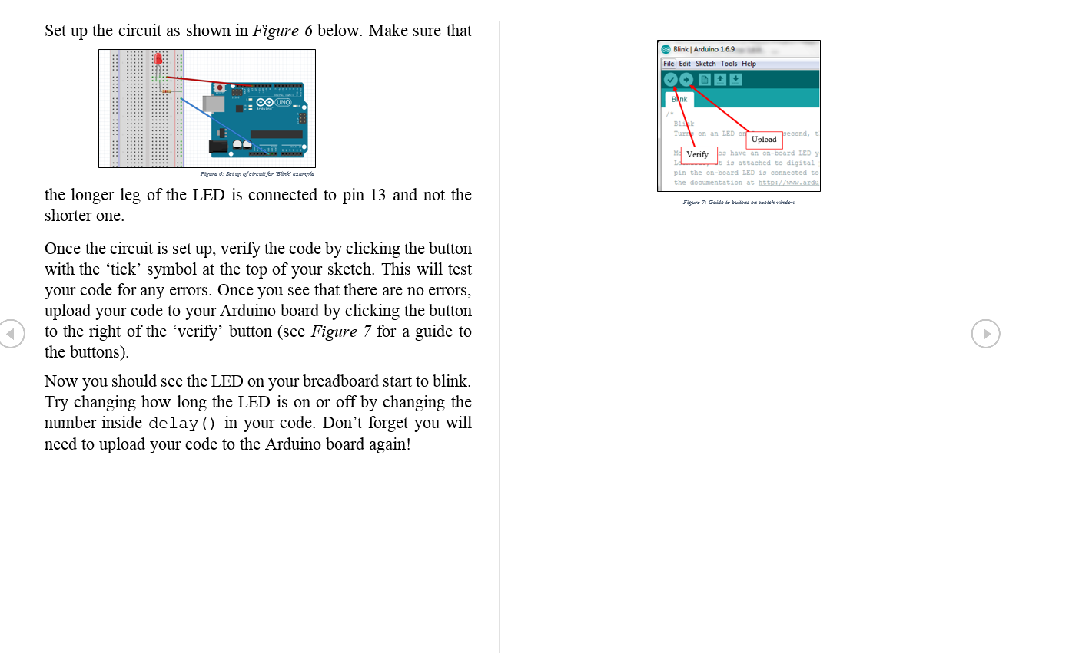
Handbook
Samples

Slide 8
Demonstration

Slide 9
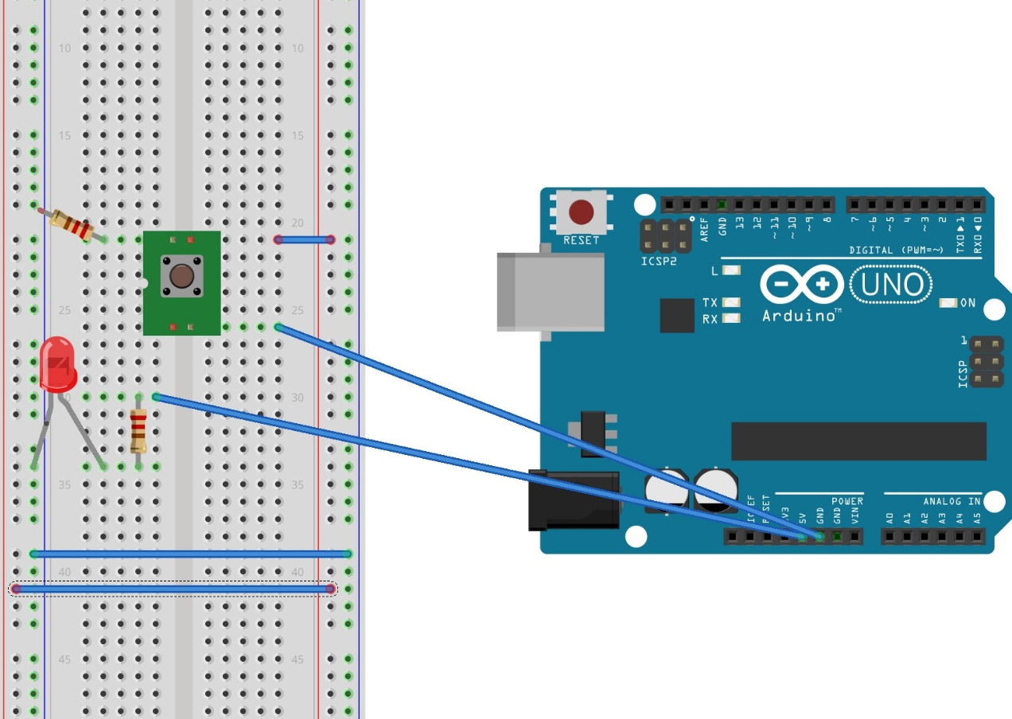
Circuits
Flashing LED

Slide 10
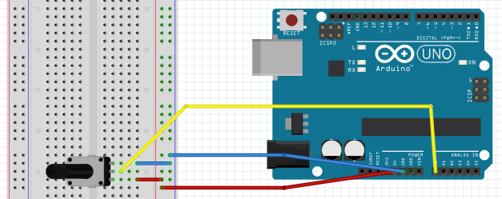
Circuits
Reading Values

Slide 11
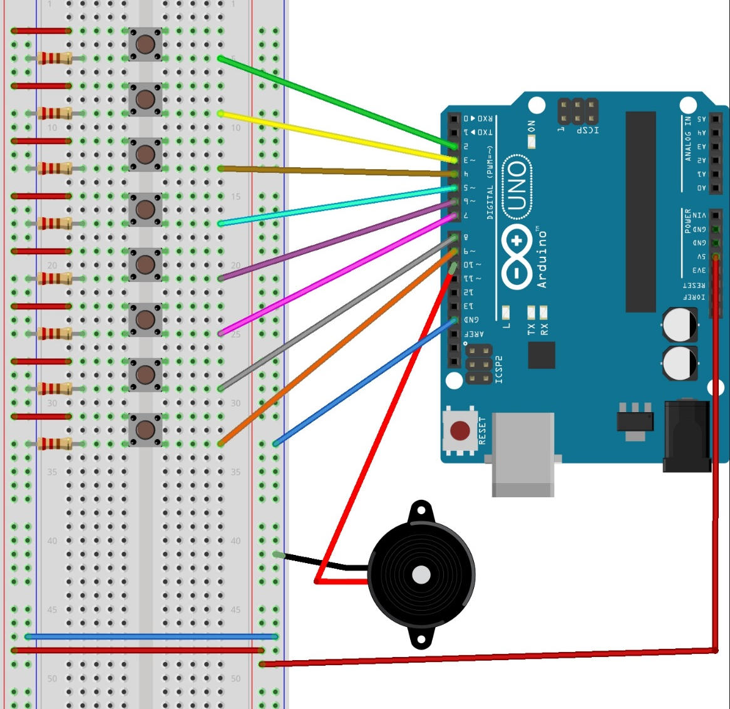
Circuits
Piano

Slide 13
Arduino Specifications
14 digital inputs / outputs (including 6 which are PWM capable)
6 analog inputs
32kB flash memory, 2kB SRAM, 1kB EEPROM
Clock speed 16 MHz
Powered by USB or external power supply

